Slide 1
High School Student Analysis
Capstone Project – Applied Mathematics Graduate Degree

Slide 2
Analysis
This will be a study on students and the classes they have taken and requested. The data includes teacher survey data, student final grades by year and data for appeals granted/denied for students looking to take honors courses.
We will be investigation relationships within our Data to see what impacts a students success in High School

Slide 3
Tools/Analysis Plan
Python
Machine Learning
Qlik Sense Visualization
Trend Analysis
CHI- Sqaured Test
OLS Regression

Slide 4
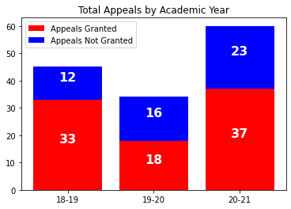
Academic year 19-20 saw a 20% drop in total appeals from the 18-19 academic years.
While the total number of appeals increased for the 20-21 academic this only saw a 9% increase in the number of granted appeals.
On average about 63% of appeals have been granted since the 18-19 academic year.
Academic Year | Percent Appeals Granted
18-19 | 73%
19-20 | 53%
20-21 | 62%

Slide 5
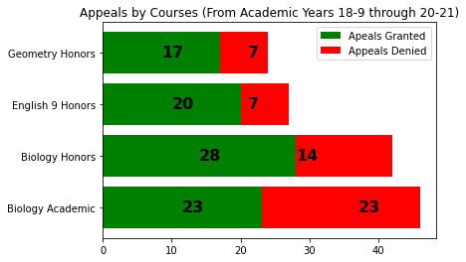
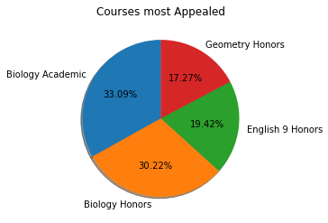
Most Appealed Courses
While Biology Honors and Biology Academic have received the most appeals by students, English 9 and Geometry Honors appeals have been granted more frequently. About 70% of Geometry Honors and 74% of English Honors appeals have been granted while 67% of Biology Honors and 50% of Biology Academic have been granted.

Slide 6
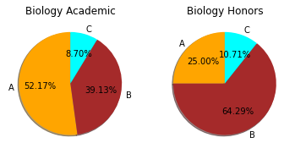
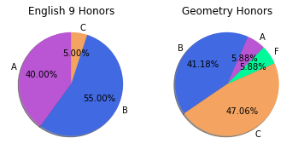
Granted Appeals
Most students whose appeals are granted go on to pass their courses.
If we recall from the previous slide, Geometry has a 70% approval rate for appeals. Of those appeals that are granted, we do start to see fewer A’s and more C’s while we also begin to fails for the course (1 student failed in the data).

Slide 7
Granted Appeals
Appeal Granted 9th Grade | Grade Directional Level | 10th Grade Likelihood | 11th Grade Likelihood
Biology Academic | Down | 4% | 20%
Biology Academic | Same | 65% | 60%
Biology Academic | Up | 30% | 20%
Biology Honors | Down | 14% | 35%
Biology Honors | Same | 86% | 6%
Biology Honors | Up | 0% | 59%
English 9 Honors | Down | 15% | 9%
Englsih 9 Honors | Same | 85% | 27%
English 9 Honors | Up | 0% | 64%
Geometry Honors | Down | 65% | 25%
Geometry Honors | Same | 35% | 62%
Geometry Honors | Up | 0% | 12%

Slide 8
Granted APpeals
Appeal Granted 9th Grade | 10th + 11th Grade Tracked | Likelihood
Biology Academic | Down + Same | 7%
Biology Academic | Same + Same | 53%
Biology Academic | Same + Up | 7%
Biology Academic | Up + Down | 20%
Biology Academic | Up + Up | 13%
Biology Honors | Down + Same | 6%
Biology Honors | Down + Up | 6%
Biology Honors | Same + Down | 35%
Biology Honors | Same + Up | 53%
English 9 Honors | Down + Same | 9%
English 9 Honors | Same + Down | 9%
English 9 Honors | Same + Same | 18%
English 9 Honors | Same + Up | 64%
Geometry Honors | Down + Same | 62%
Geometry Honors | Down + Up | 12%
Geometry Honors | Same + Down | 25%

Slide 9
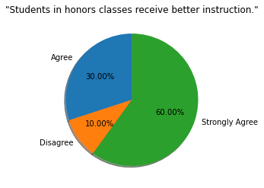
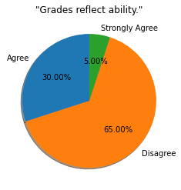
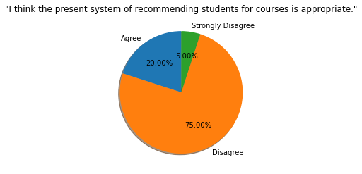
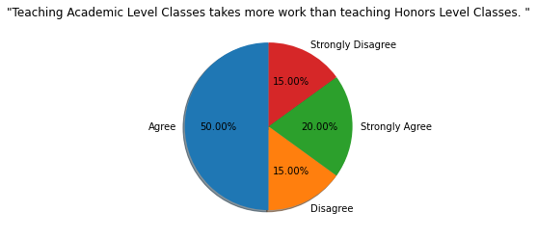
Survey Results (20 Observations)

Slide 10
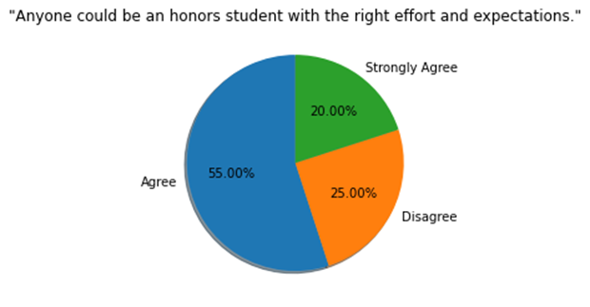
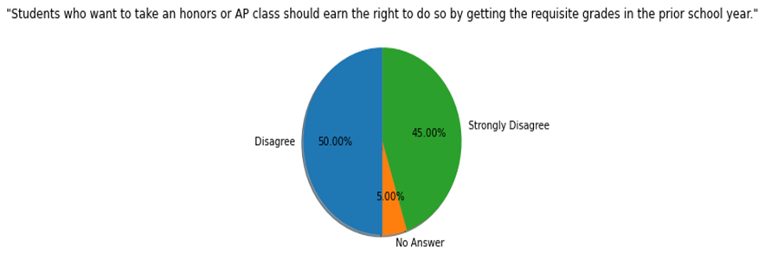

Survey Results (20 Observations)

Slide 11
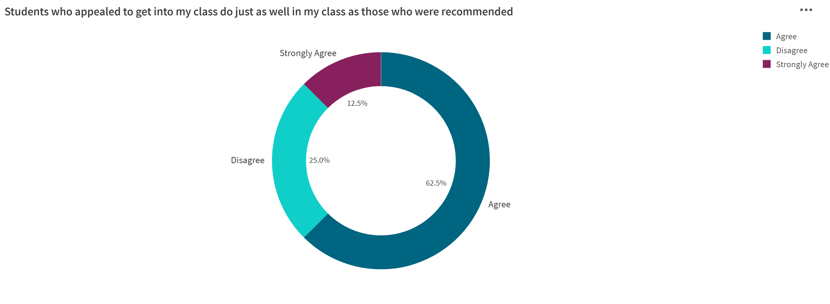
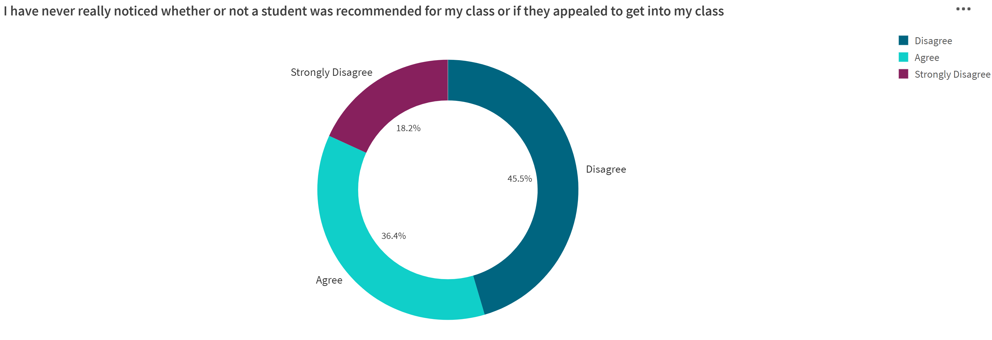
Survey Results (20 Observations)

Slide 12
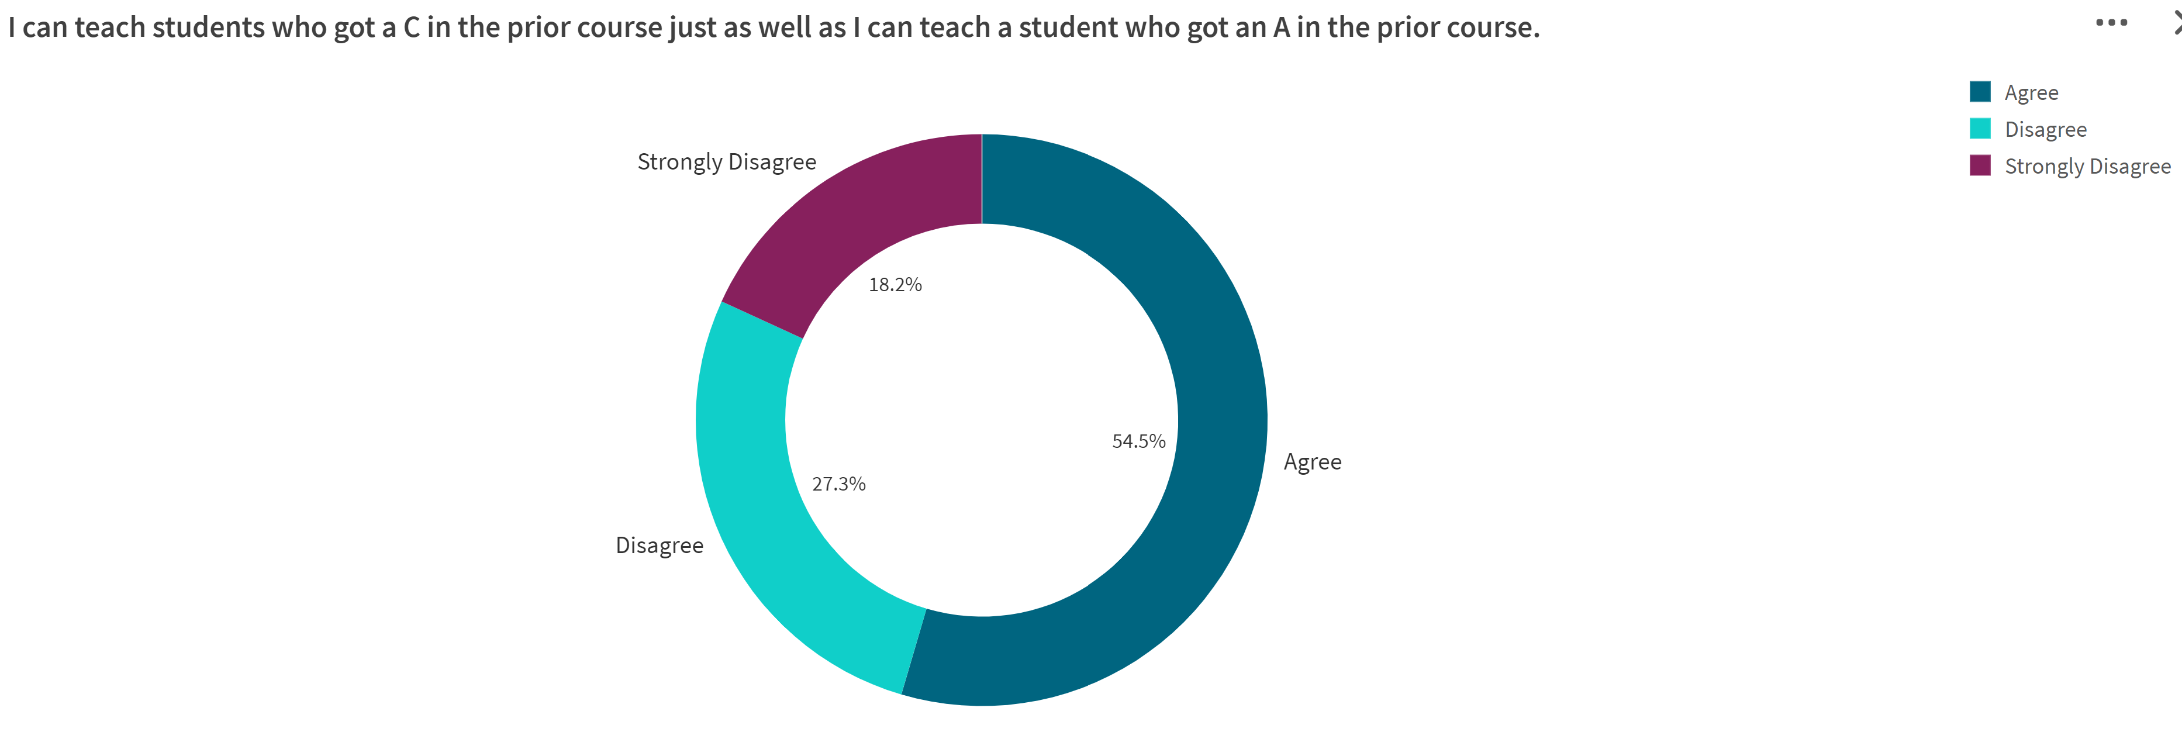
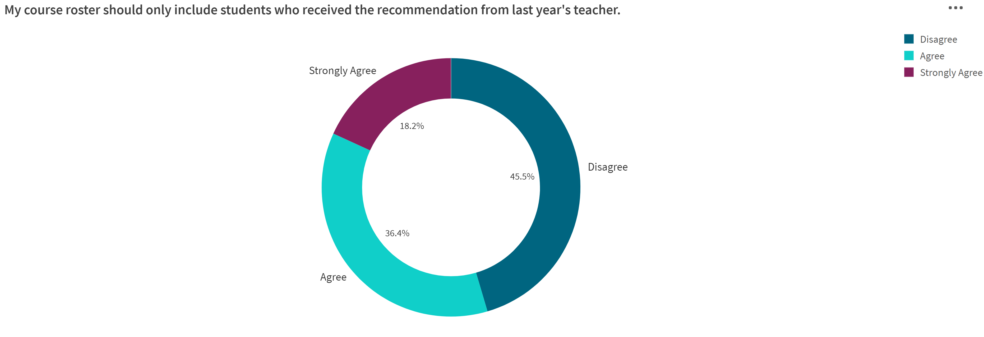
Survey Results (20 Observations)

Slide 13
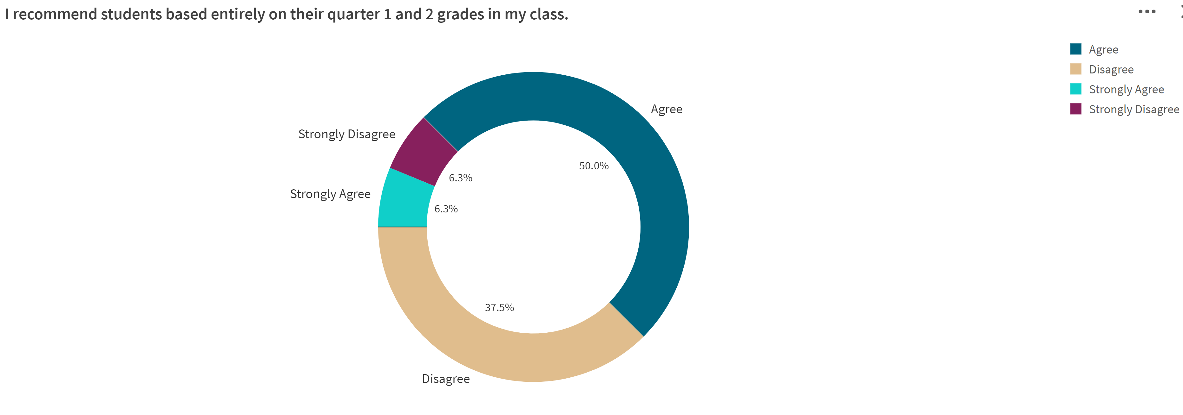
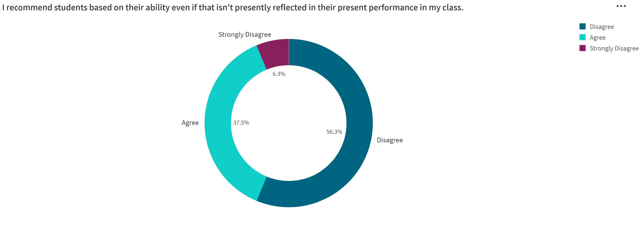
Survey Results (20 Observations)

Slide 14
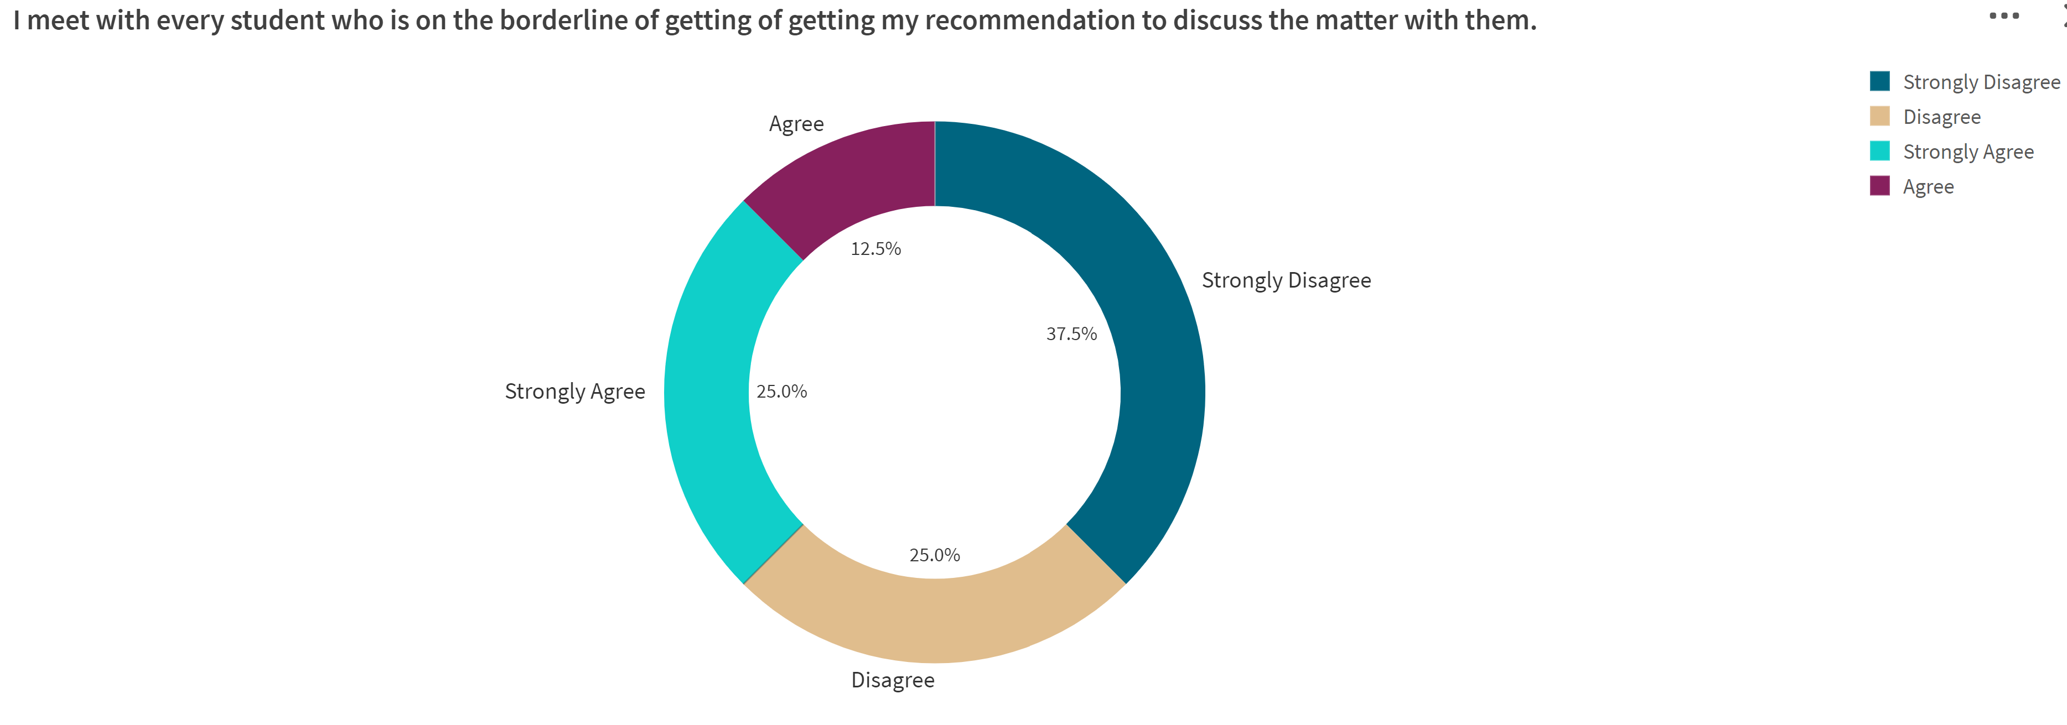
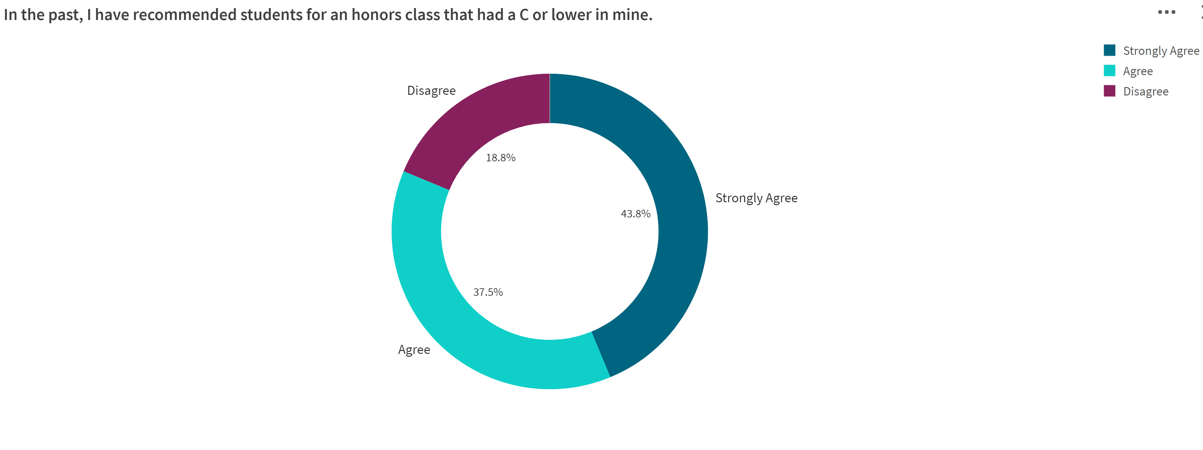
Survey Results (20 Observations)

Slide 15
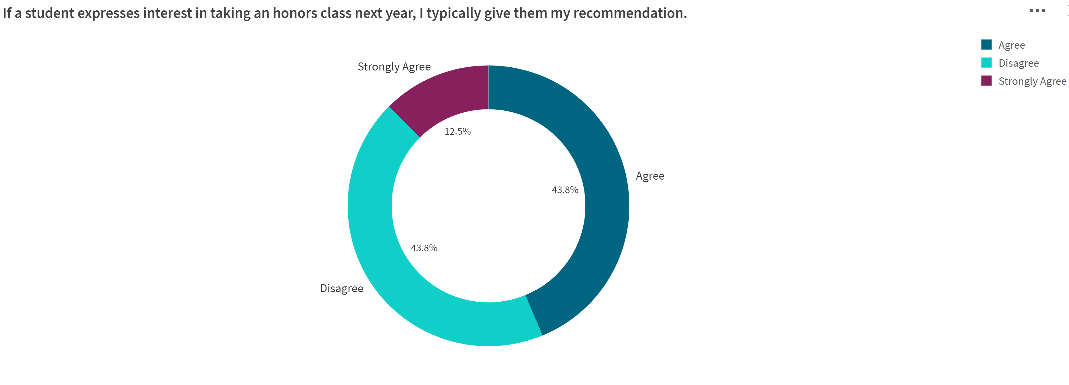
Survey Results (20 Observations)

Slide 16
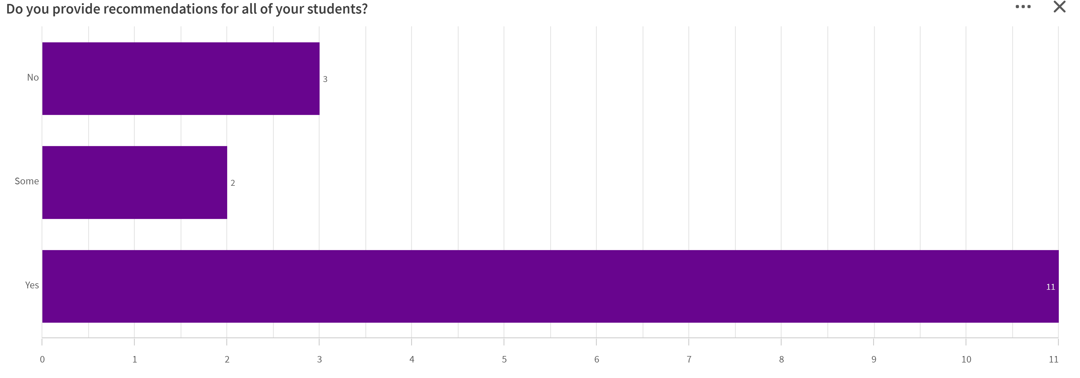
Survey Results (20 Observations)

Slide 17
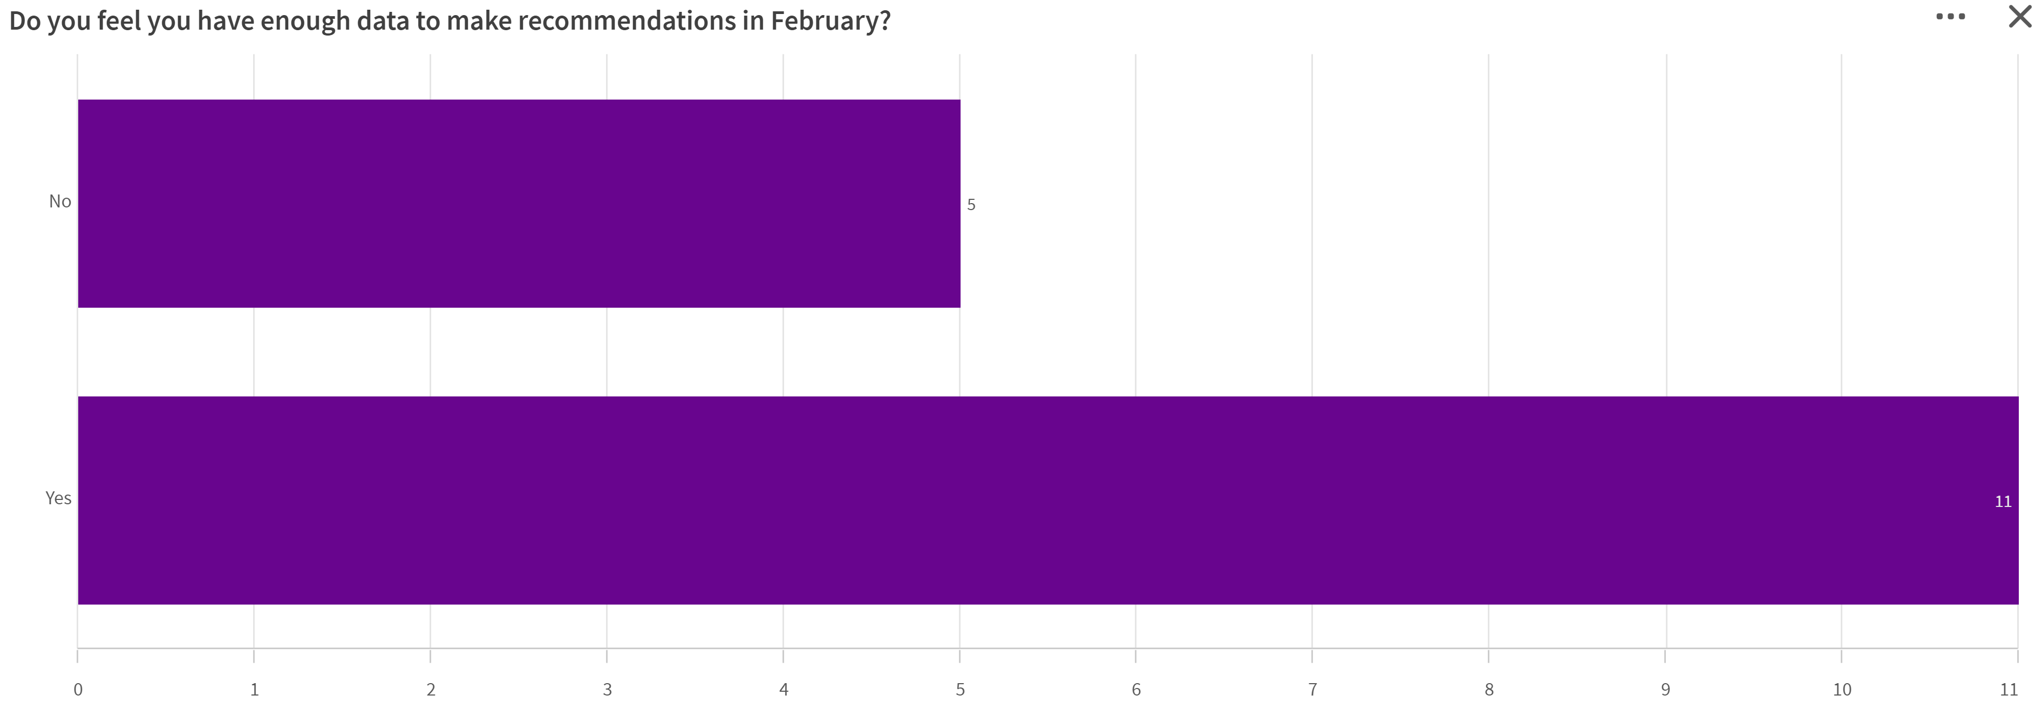
Survey Results (20 Observations)

Slide 18
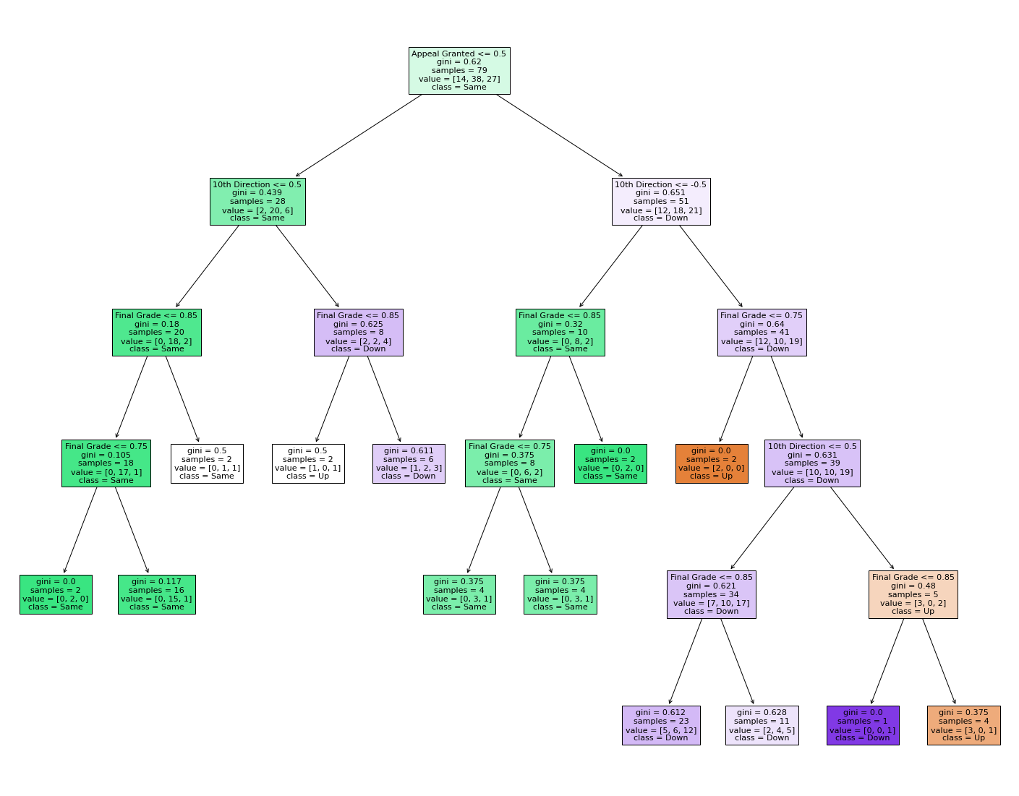
Appeals Granted Decision Tree Predictions for 11th Grade
Decision Tree Accuracy: 0.67
Random Forest Accuracy: 0.48
Naives Bayes Accuracy: 0.63
XGB Accuracy: 0.67
Note: Including the field Grade Cohort does give better results within the data model. However, this may be due to the fact that we are now dealing with groupings between the different years. Since we are separating the data between the years Grade Cohort was left of the Data model.

Slide 19
1. low R-square and low p-value (p-value <= 0.05)
It means that your model doesn’t explain much of variation of the data but it is significant (better than not having a model)
2. low R-square and high p-value (p-value > 0.05)
It means that your model doesn’t explain much of variation of the data and it is not significant (worst scenario)
3. high R-square and low p-value
It means your model explains a lot of variation within the data and is significant (best scenario)
4. high R-square and high p-value
It means that your model explains a lot of variation within the data but is not significant (model is worthless)

Slide 20
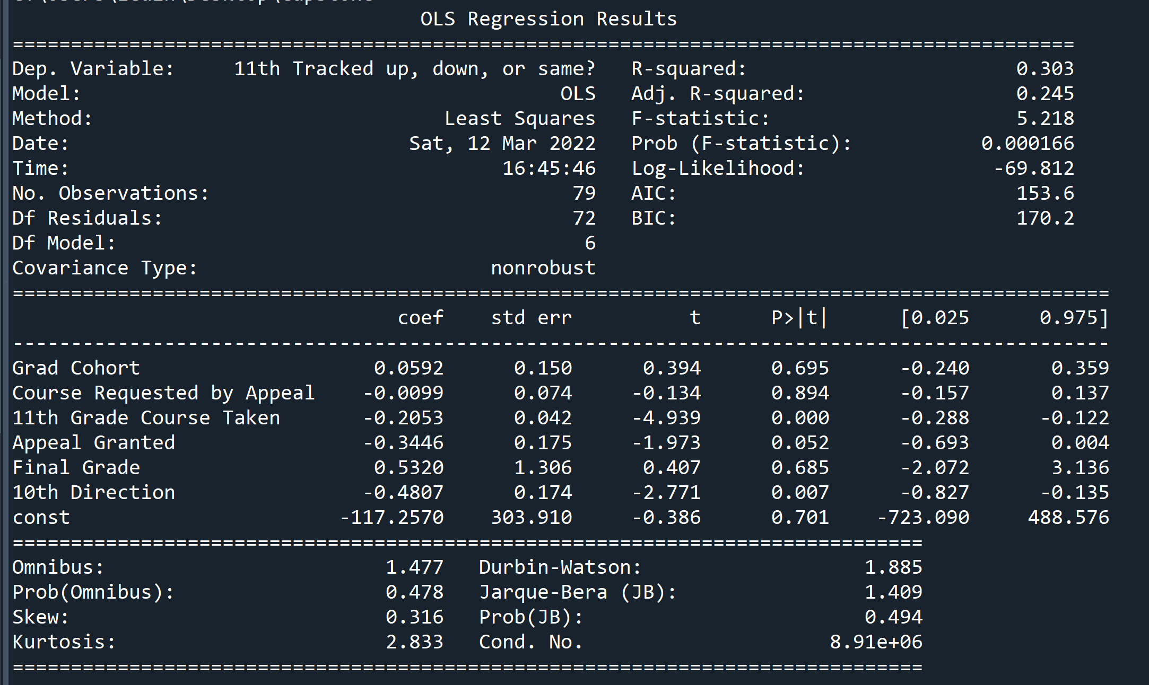
OLS Regression
Here we have a p value of 0.000166 which does indicate some correlation within our data model. However, a low R-square value of 0.303 may suggest that our results may not be statistically significant.
P>|t| values
Here we see stronger correlation between the values Grad Cohort, Course requested by Appeal and the Appeal being Granted or not to our Dependent Variable(11th Tracked up, down, or same).
A 0.00 value for 11th Grade Course Taken makes sense since this value is part of our Dependent Variable.

Slide 21
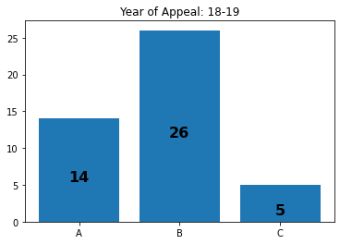
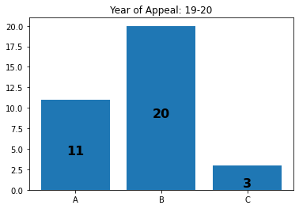
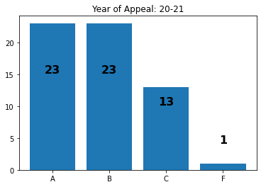
Appeals
From the Year that appeals where submitted we see that there are some years where students overall did better. We do see more students get C’s and we do start to see an F for 20-21 years, this could be attributed to fact that overall there where students who submitted appeals to track up.

Slide 22
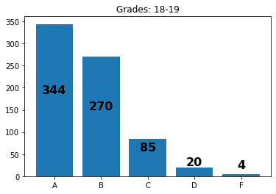
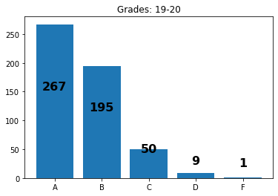
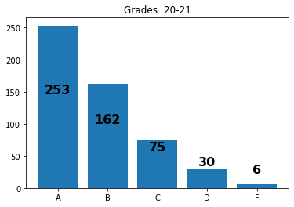
Letter grade analysis
Note that the previous charts are from the the data of those who appealed. This charts is from the data of students who where either recommended or appealed.
From our charts here, we see consistency in student grades year over year with in all of the courses taken. Which is in indication that nothing alarming happened in a specific academic year to cause any skewing within our data

Slide 23
What is a Chi-square test used for?
A chi-square test is a statistical test used to compare observed results with expected results. The purpose of this test is to determine if a difference between observed data and expected data is due to chance, or if it is due to a relationship between the variables you are studying.

Slide 24
Chi Squared Test
The appeal being granted and 10th grade directional track (Up, down or same).
P = 5.160825751186612e-07.
Indicates a correlation between the variables which logically makes sense since if the appeal is granted students are more likely to track up and vise versa.
The appeal being granted and 11th grade directional track (Up, down or same).
P = 0.0065328368015667064.
We still have some correlation in the 11th grade directional track from when the appeal was initially granted.

Slide 25
Chi squared test
Is there a relation between the Appeals Granted and the Course that is being requested by the Appeal?
P = 0.22121433030882745
Here we see that Appeals being Granted and the course that is being requested are two Independent variables.
The course being appealed and 10th grade course taken
p = 4.5840887535325845e-11
We do see a strong relation ship between the two values. And we do see better grades in some of the courses taken. We can determine what course they requested in the appeal will have an effect on the course a student takes in 10th grade.
The course being appealed for and the 11th grade course taken
p = 2.4459405218950663e-05
We see that there is also a relation between what course is appealed for and what course a student will take in their 11th grade year.

Slide 26
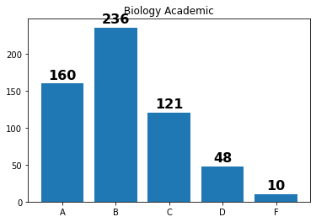
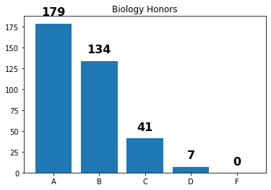
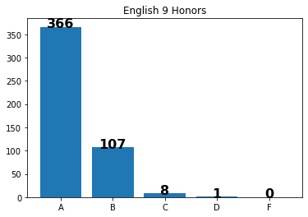
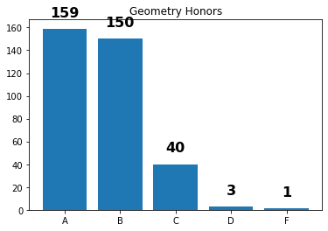
Letter Grades by course
P = 3.727912810478004e-67
The small P-value indicates a storng relation between a student’s grade and their academic course.
We do start seeing F and D’s in certain courses from the charts. The Biology course do see a higher number of appeals while Geometry does have a lower number of appeals overall year over year.

Slide 27
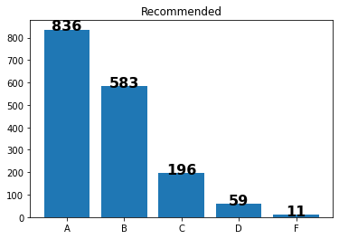
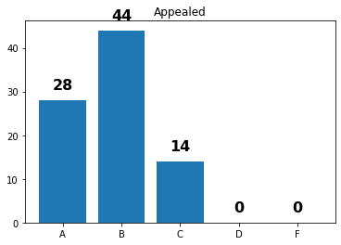
Letter grades by status
P = 0.0006508576422942924
We do also see a correlation between overall grades and students who are either recommended or appeal for their courses.
Overall there have been more students who have been recommended to track up. However, statistically those who appealed performed better even though there where fewere of them.

Slide 28
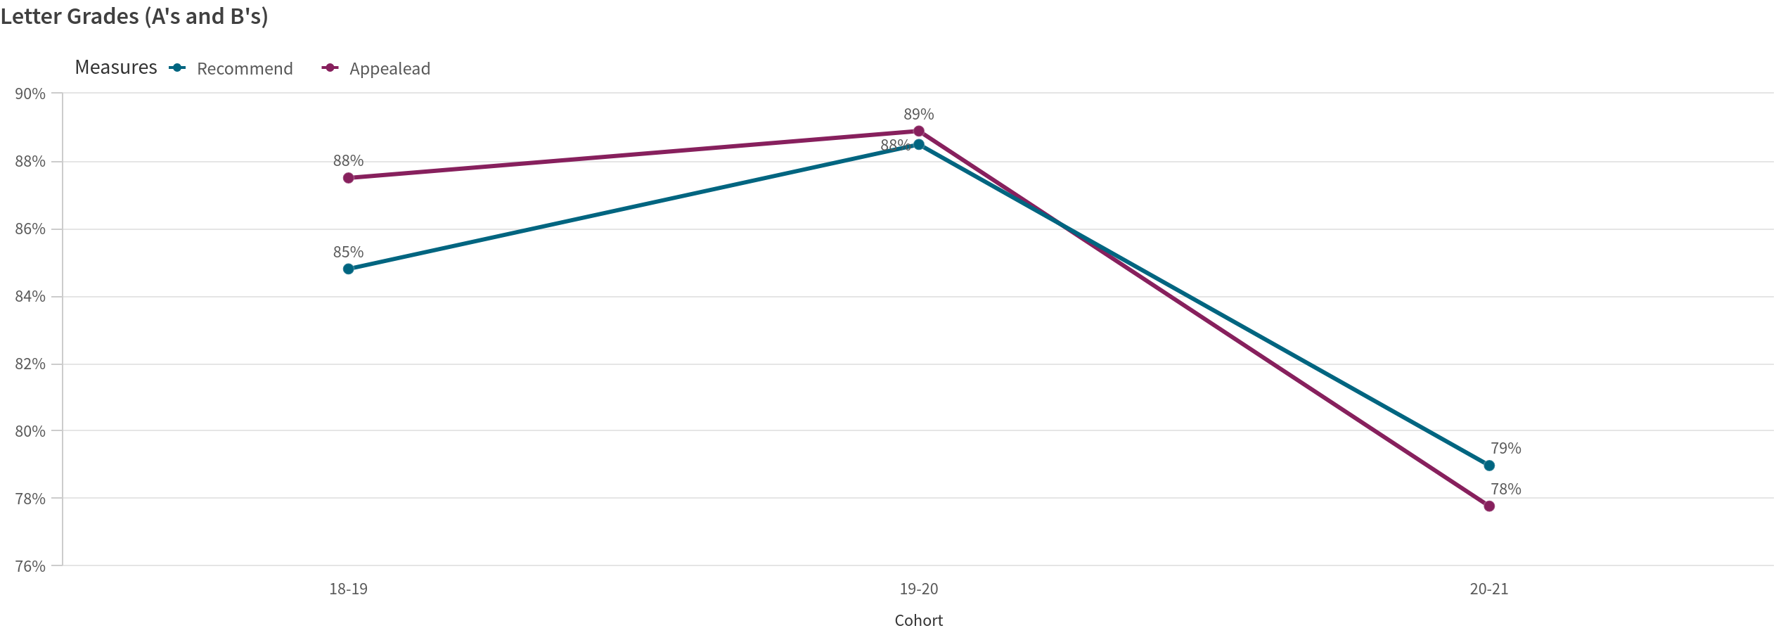
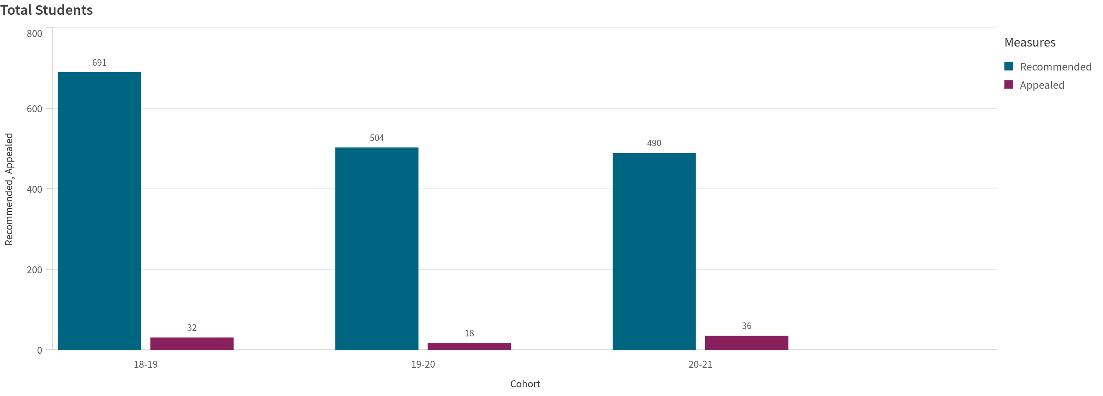
Recommendations
Even though there is a significantly higher number of students who are recommended, students who appeal their course tend to do a little better overall. The exception being the final academic codhort.

Slide 29
Cohort Recommend Appealead
18-19 85% 88%
19-20 88% 89%
20-21 79% 78%
Cohort Recommended Appealed
18-19 691 32
19-20 504 18
20-21 490 36

Slide 30
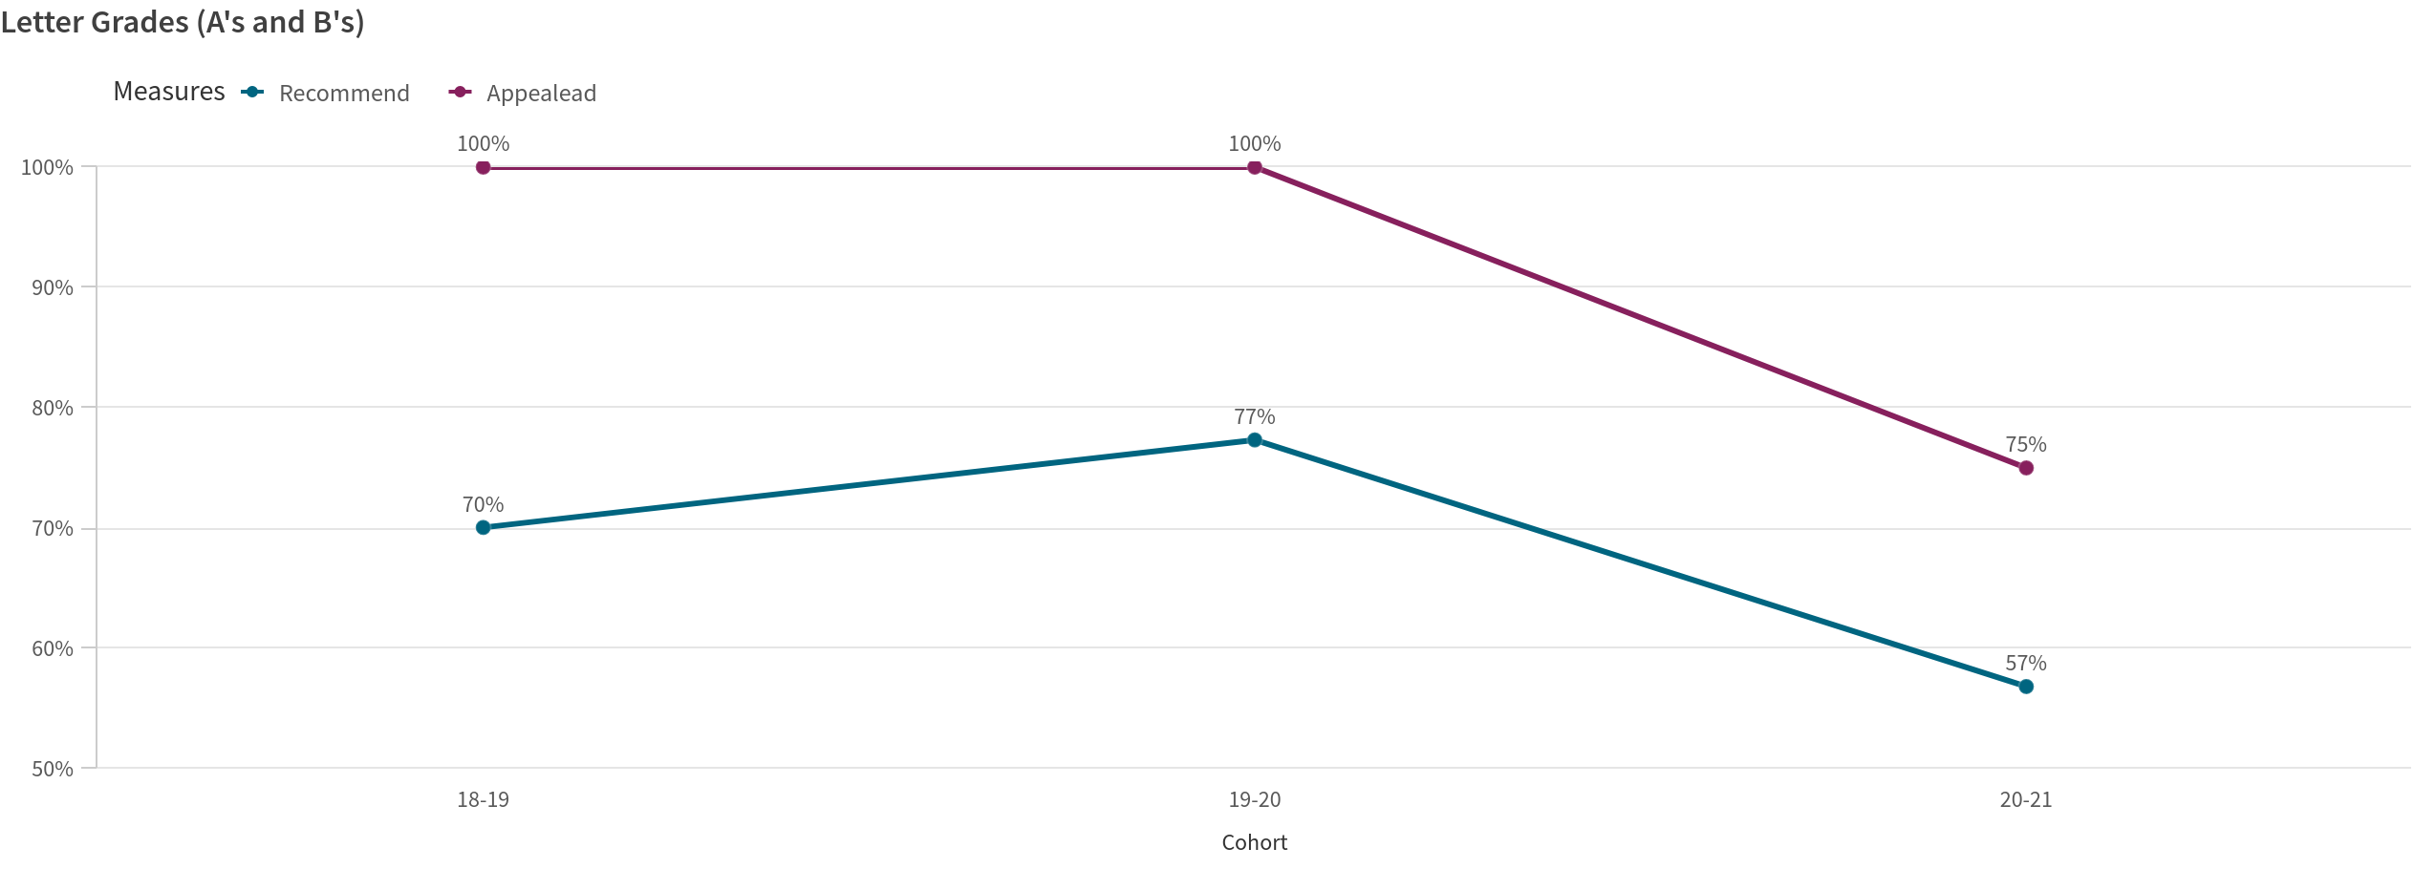
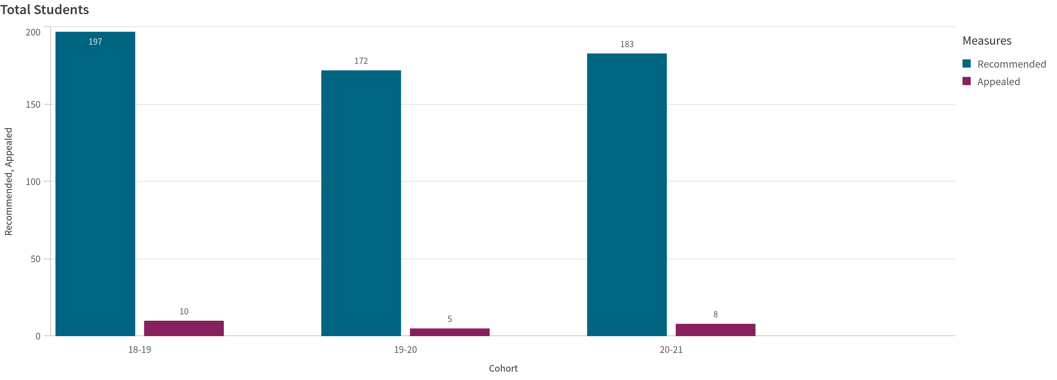
Biology Academic
Percentage wise there is better performance amongst students who appealed for the Biology Academic course.

Slide 31
Biology Academic
Cohort Recommend Appealead
18-19 70% 100%
19-20 77% 100%
20-21 57% 75%
Cohort Recommended Appealed
18-19 197 10
19-20 172 5
20-21 183 8

Slide 32
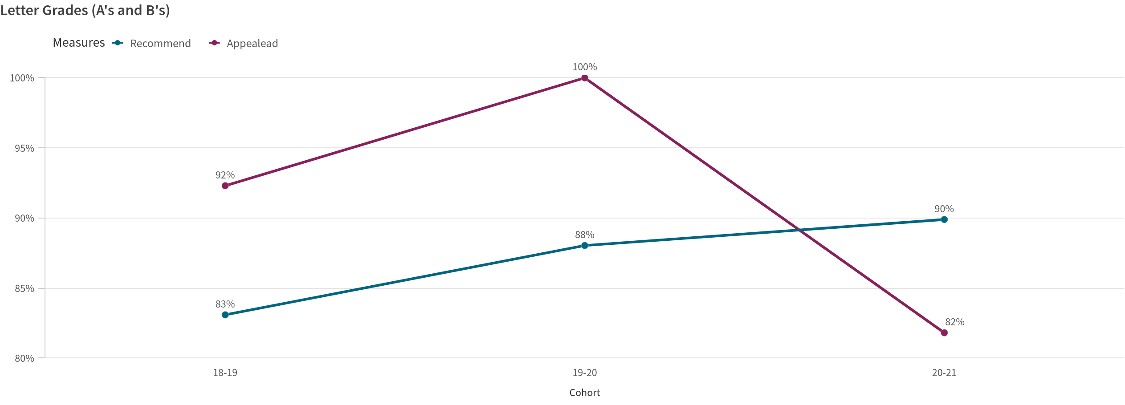
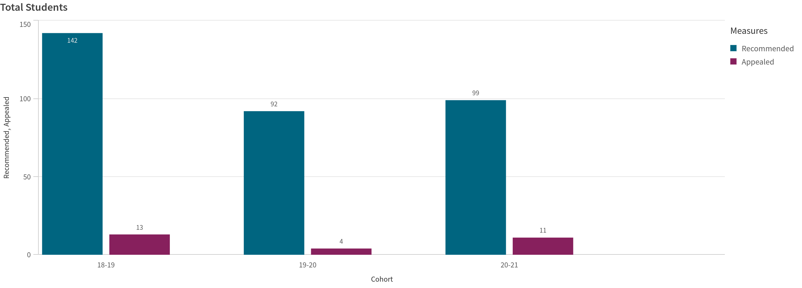
Biology Honors
Except for the final academic cohort we do see students who appealed for Biology Honors have normally performed better.

Slide 33
Biology Honors
Cohort Recommend Appealead
18-19 83% 92%
19-20 88% 100%
20-21 90% 82%
Cohort Recommended Appealed
18-19 142 13
19-20 92 4
20-21 99 11

Slide 34
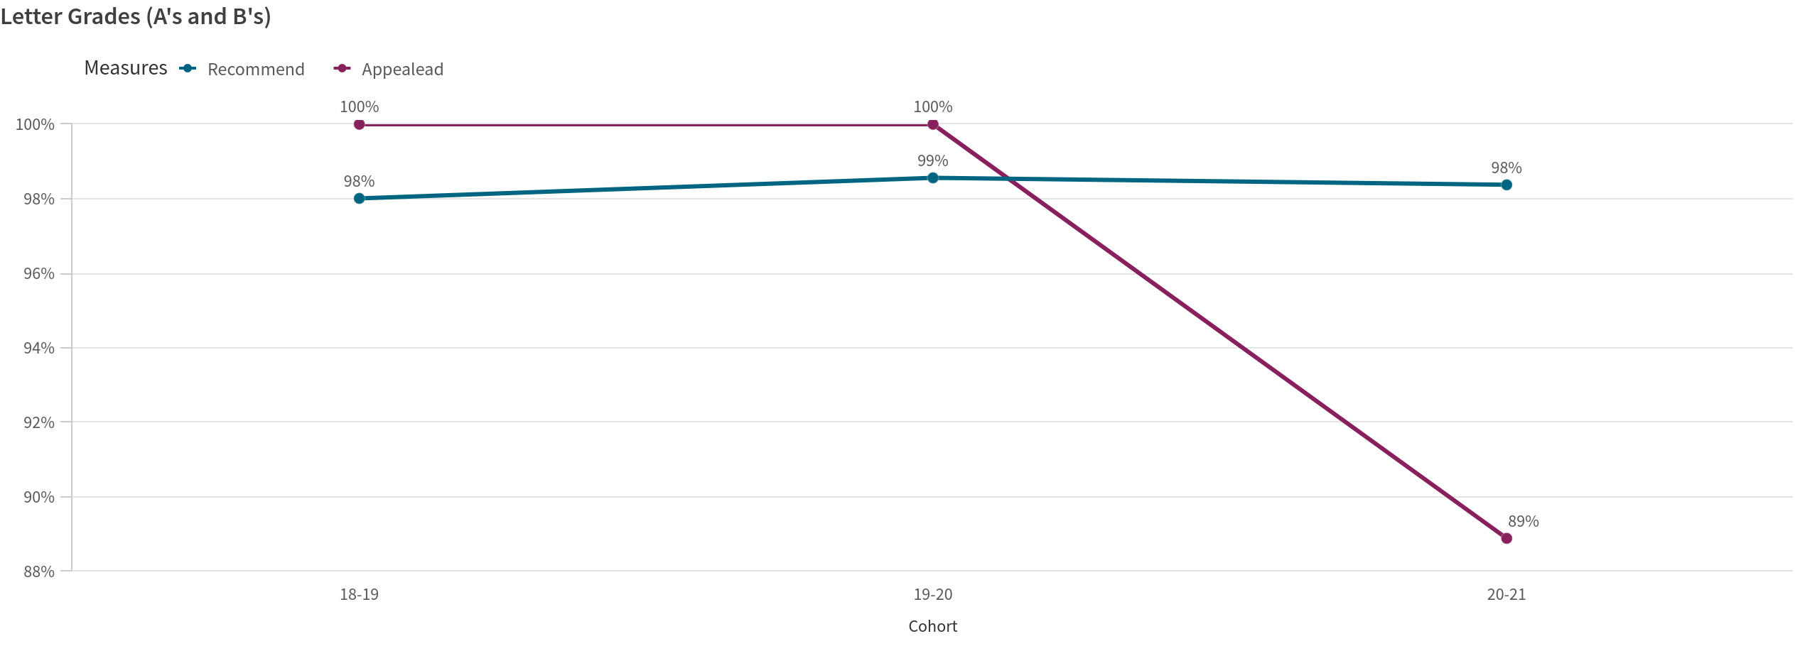
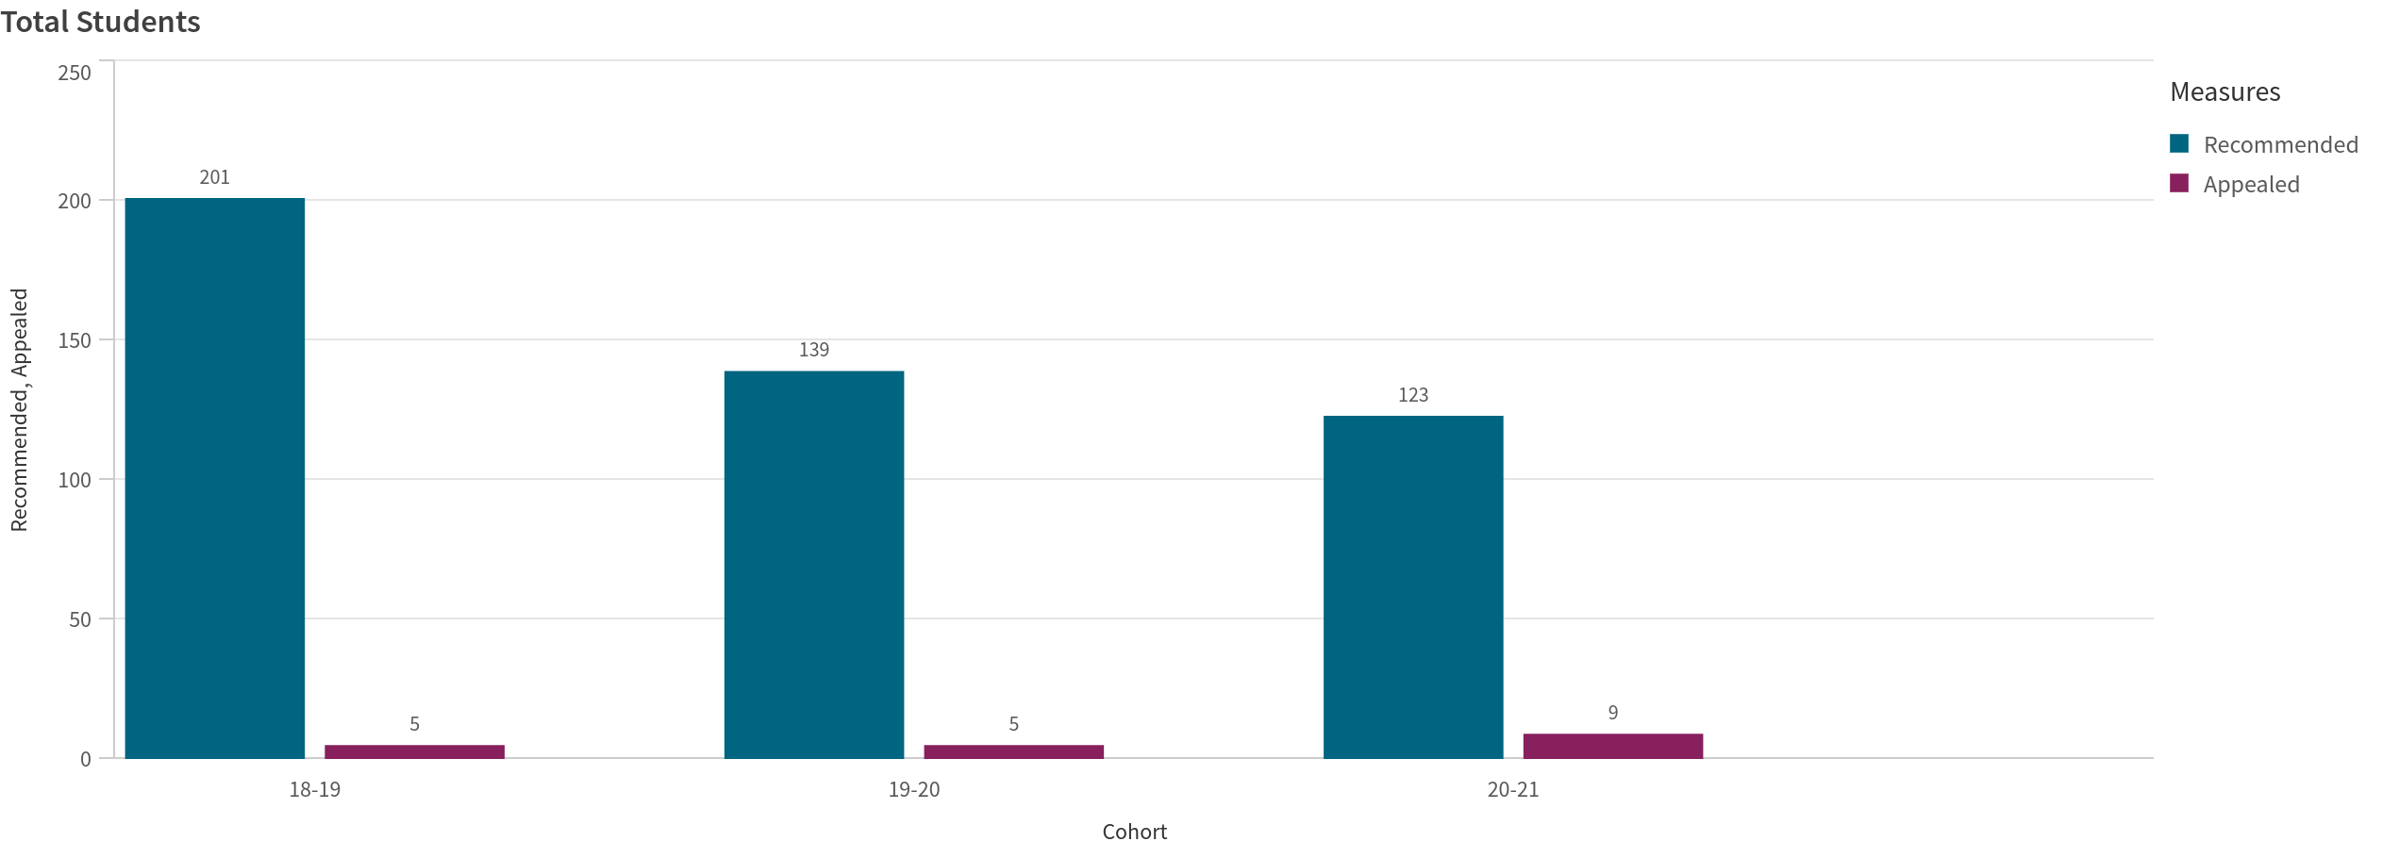
English 9 Honors
For English 9 Honors we do see a drop in performance the final academic cohort which there was 4 more students accepted who appealed. But for the most part you do see a high level of performance overall.

Slide 35
English 9 Honors
Cohort Recommend Appealead
18-19 98% 100%
19-20 99% 100%
20-21 98% 89%
Cohort Recommended Appealed
18-19 201 5
19-20 139 5
20-21 123 9

Slide 36
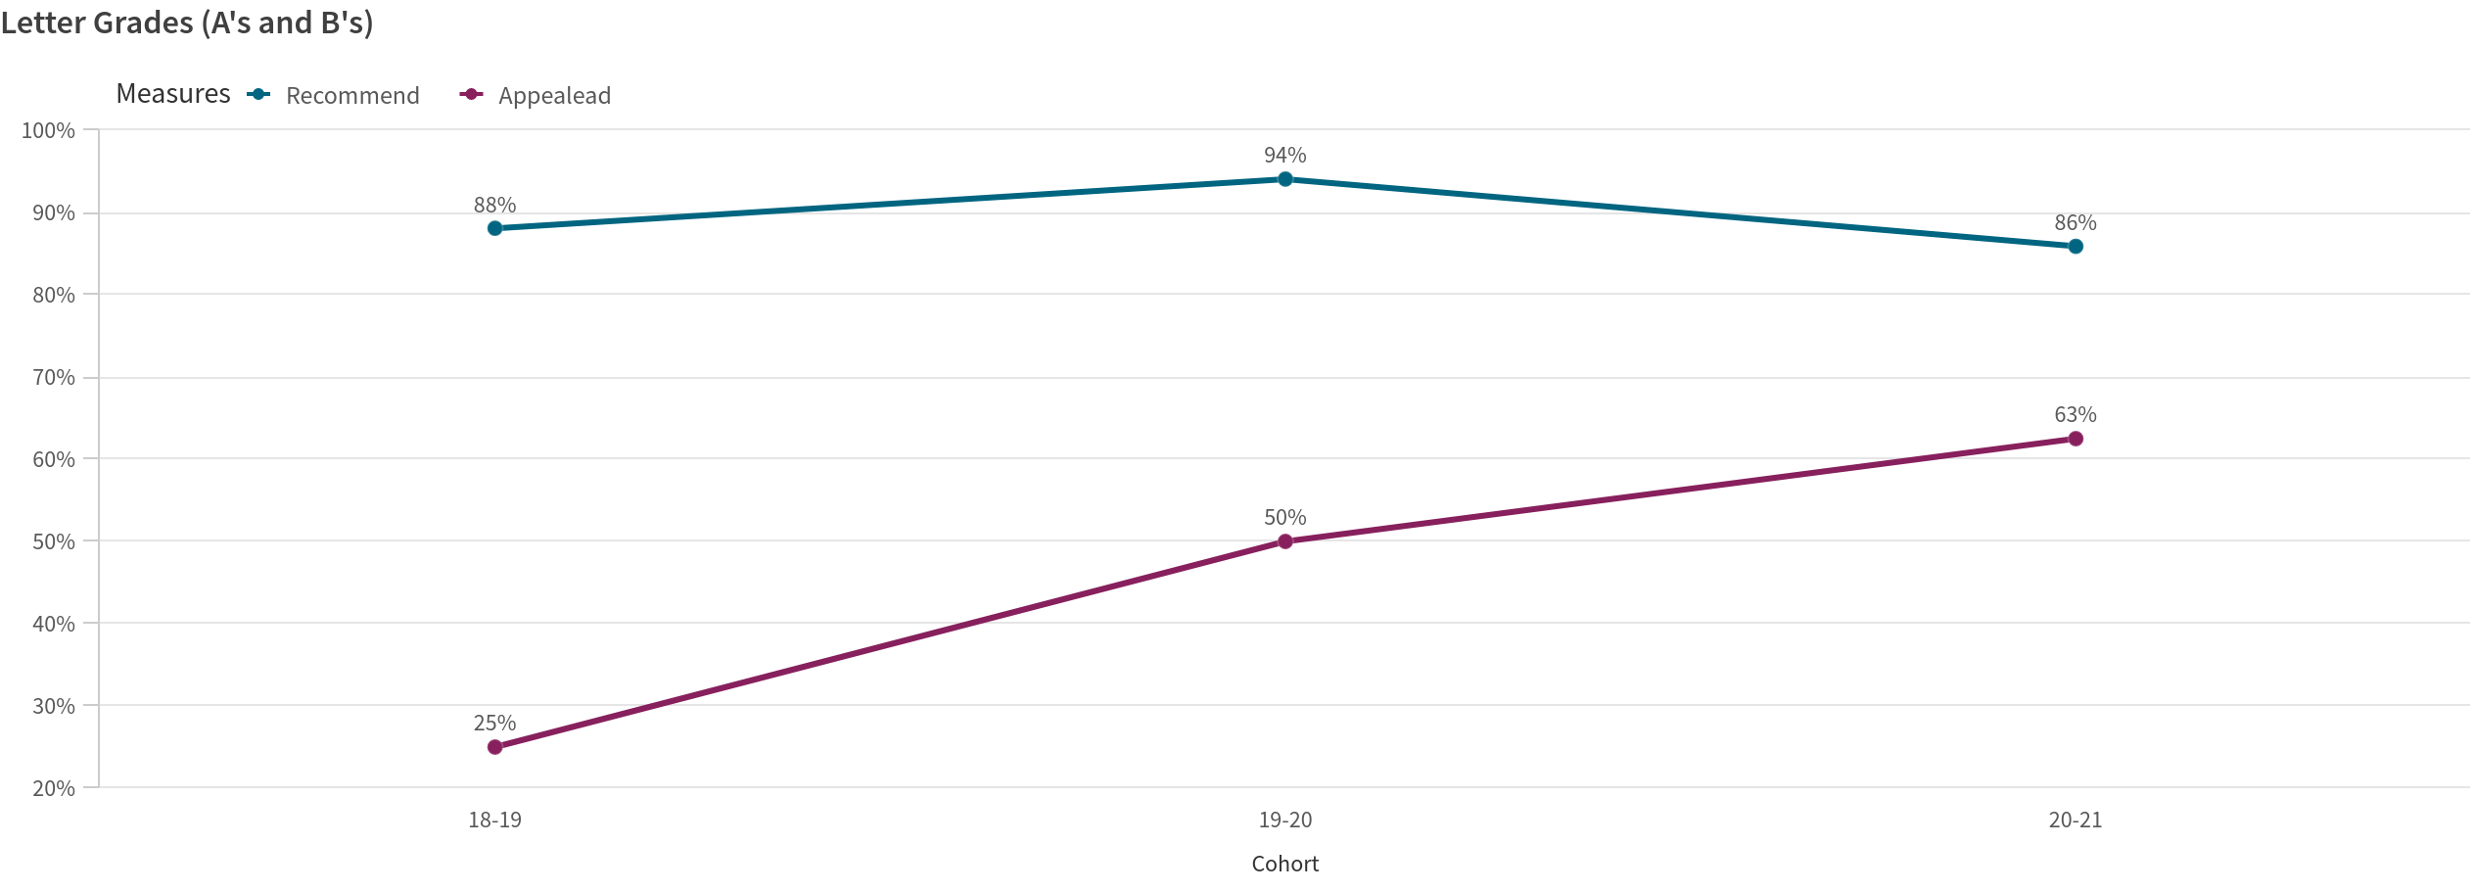
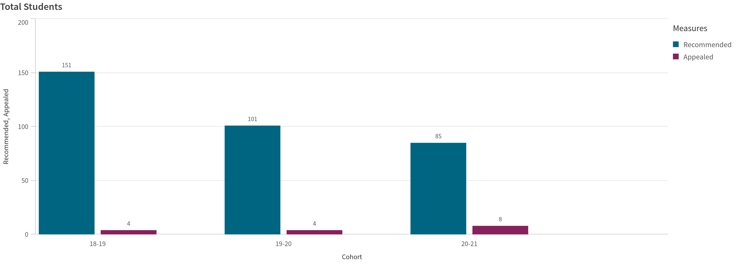
Geometry Honors
Overall we do see stronger performance within the Students who are recommended vs those appeal.
However, we do see an upward trend for those students who appeal Geometry Honors.
We did have 4 more students accepted who appealed into Geometry Honors.

Slide 37
Geometry Honors
Cohort Recommend Appealead
18-19 88% 25%
19-20 94% 50%
20-21 86% 63%
Cohort Recommended Appealed
18-19 151 4
19-20 101 4
20-21 85 8

Slide 38
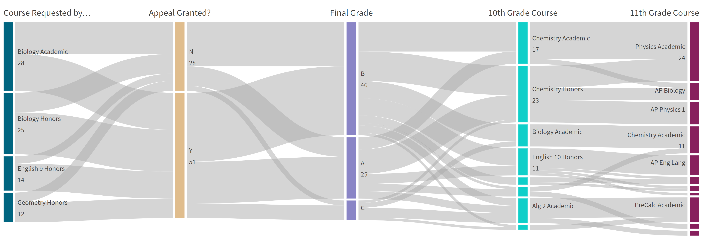

Slide 39
